Slide 1
Scope
Scope determines the region of the program in which a defined object is visible. Scope pertains to any object that can be declared, such as a variable or
a function declaration.
Topics discussed in this section:
Global Scope
Local Scope

Slide 2
Scope for Global and Block Areas

Slide 3
Note
Variables are in scope from declaration until the end of their block.

Slide 4
Programming Example: Incremental Development
Top–down development, a concept inherent to modular programming, allows us to develop programs incrementally. By writing and debugging each function separately, we are able to solve the program in smaller steps, making the whole process easier.
Topics discussed in this section:
First Increment: main and getData
Second Increment: add
Final Increment: Print ResultsThe

Slide 5
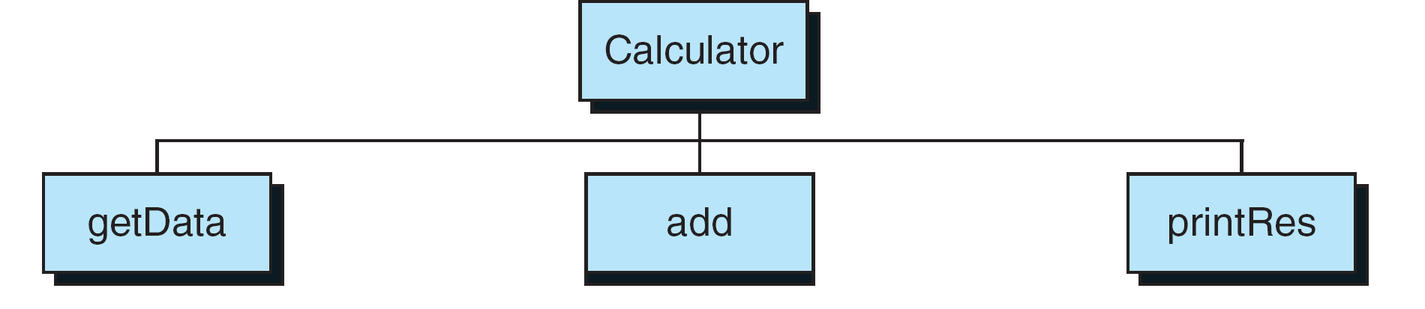
Calculator Program Design

Slide 6
Calculator Program—First Increment

Slide 7
Calculator Program—First Increment

Slide 8
Calculator Program—First Increment

Slide 9
Calculator Program—Second Increment

Slide 10
Calculator Program—Second Increment

Slide 11
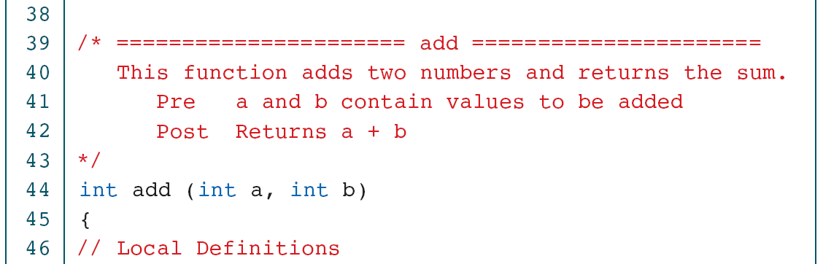
Calculator Program—Second Increment

Slide 12

Calculator Program—Second Increment

Slide 13
Calculator Program—Final Increment

Slide 14
Calculator Program—Final Increment

Slide 15
Calculator Program—Final Increment

Slide 16
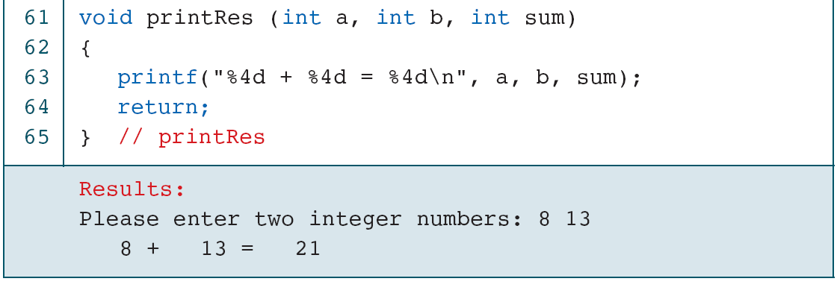
Calculator Program—Final Increment

